Slide 1

Repository Extension Points

Slide 2
Table of Contents
Repository extension points - • Actions • Behaviors/Policies • JavaScript root scoped objects • Solr query overview • Scheduled Jobs • Patches Workflows (Introduction) - • Workflow Overview • Workflow definition file components • Deployment options

Slide 3
Repository extension points
The Alfresco Content Services platform features a number of extension points that can be used to create customizations.
Extending the platform repository is a fundamental part of any content management project, and in most cases it starts with designing and deploying a custom content model suited to a specific domain. Custom REST APIs and processes are then developed to make use of this domain specific content model.
Building custom content-driven web applications involves modeling semantic content inside the repository and then wrapping business logic around the content.
3

Slide 4
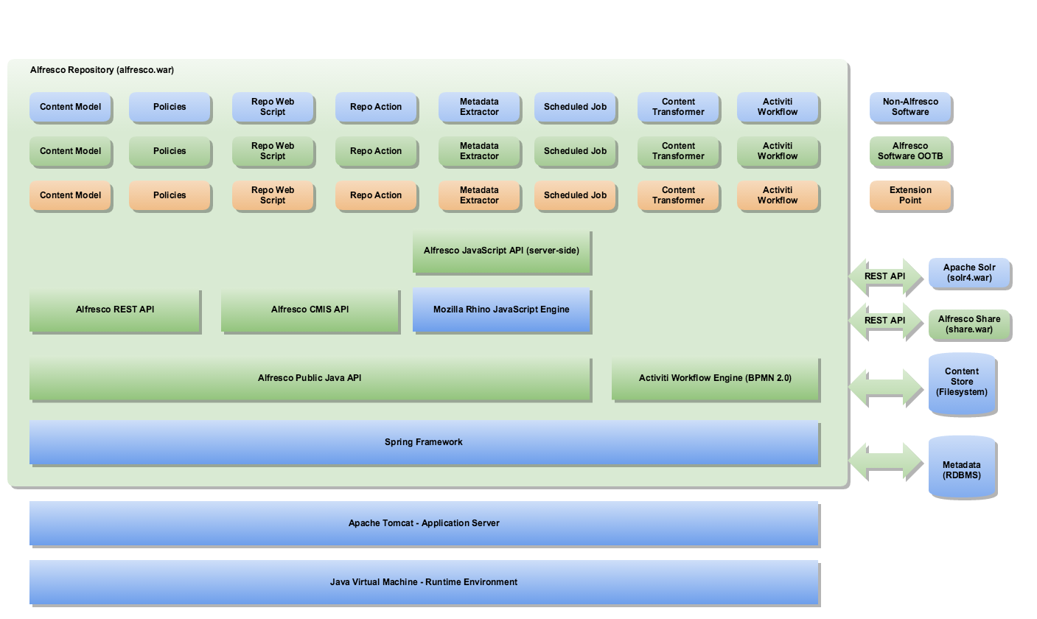
Repository extension points
The following diagram illustrates the platform architecture and extension points
4

Slide 5
Repository extension points
Some common extension points include:
Actions
Behaviors/Policies
Javascript root scoped objects
Scheduled Jobs
Patches
Workflows
5

Slide 6
Actions
An Action is a discrete unit of work that can be invoked repeatedly. It can be invoked from a number of Alfresco features, such as Folder Rules, Workflows, Web Scripts, and Scheduled Jobs.
The following are examples of out-of-the-box actions: Check-Out, Check-In, Update, Add Aspect, Copy, Cut, Paste, Send Email, Move, Specialize Type, Edit, and Delete.
Actions are Spring beans that act upon a content node. You develop actions using Java and register them with the repository through a Spring configuration file. Actions provide the ideal place to put your common, highly reusable business logic. You can then call these actions from within the repository for any number of content objects.
6

Slide 7
Behaviors/Policies
Behavior Policies can be used to run custom code when an event, such as adding a content item or deleting a content item, happens.
Sometimes, using rules might not be enough for what we want to do.
Let's say that we wanted to execute a business rule just before a node is deleted and a business rule after the node has been deleted. This cannot be done with rules, as they allow us to execute business rules only when nodes are created, deleted, or updated.
7

Slide 8
Cont..
The events that we can listen to are associated with the service that triggers them. Here's a list of some of the event policies:
org.alfresco.repo.content.ContentServicePolicies (OnContentUpdatePolicy, OnContentPropertyUpdatePolicy etc)
org.alfresco.repo.copy.CopyServicePolicies (OnCopyNodePolicy, BeforeCopyPolicy etc)
org.alfresco.repo.node.NodeServicePolicies (OnCreateStorePolicy, OnCreateNodePolicy etc)
org.alfresco.repo.version.VersionServicePolicies (OnCreateVersionPolicy, OnRevertVersionPolicy etc)
8

Slide 9
Cont..
Policies available for behavior binding
Interface | Method
org.alfresco.repo.content.ContentServicePolicies | onContentPropertyUpdate,onContentRead,onContentUpdate
org.alfresco.repo.copy.CopyServicePolicies | beforeCopy,onCopyComplete,onCopyNode
org.alfresco.repo.node.NodeServicePolicies | beforeAddAspect,beforeArchiveNode,beforeCreateNode,beforeCreateStore,beforeDeleteAssociation,beforeDeleteChildAssociation beforeDeleteNode beforeMoveNode beforeRemoveAspect beforeSetNodeType beforeUpdateNode onAddAspect onCreateAssociation onCreateChildAssociation onCreateNode onCreateStore onDeleteAssociation onDeleteChildAssociation onDeleteNode onMoveNode onRemoveAspect onSetNodeType onUpdateNode onUpdateProperties
org.alfresco.repo.version.VersionServicePolicies | beforeCreateVersion,afterCreateVersion,onCreateVersion calculateVersionLabel
9

Slide 10
JavaScript Root Objects
Sometimes you might have custom Java code that you want to call from JavaScript controllers, this is possible by adding custom JavaScript root objects.
A number of JavaScript root objects are available when you are implementing a controller for a Web Script, such as companyhome,search and people.
In order to implement a custom JavaScript API it is recommended that you develop a POJO (Plain Old Java Object) that extends the base class org.alfresco.repo.processor.BaseProcessorExtension. The public methods of your class will be those that will be accessible from JavaScript.
10

Slide 11
JavaScript Root Objects
Some of Out of the box root objects.
Repo root objects.
companyhome-The company home ScriptNode. See ScriptNode API for properties and methods.
person-The ScriptNode representing the Person object of the currently authenticated user.
people- Root object providing access to and manipulation of person objects and groups
search- Root object providing access to the various Alfresco search interfaces such as FTS-Alfresco, Lucene, XPath, and Saved Search results
Surf root objects:
Following is the some commonly used list of Surf platform root-scope objects.
remote -The remote object stores details of endpoints.
Page - The page object provides a number of properties describing a page.
11

Slide 12
Cont..
Use of some commonly used Repo root objects.
Search API
The Search API provides direct access to repository level search results and Saved Search results through the search root scope object
var referenceType = "node";
// Store type, store id, node id
var reference = ["workspace", "SpacesStore", "78eb920f-fd46-41ee-9fdb-099e96da8349"];
var foundNode = search.findNode(referenceType, reference);
var nodes = search.luceneSearch("TEXT:alfresco", "@cm:modified", false);
People API
The People API provides access to Alfresco Content Services people and groups.
Ex:
var testUser = people.createPerson("joe.user", "Joe", "User", "joe.user@alfresco.com", "password", true, true);
var node = people.getGroup("GROUP_ALFRESCO_ADMINISTRATORS");
if(node){
model.members = people.getMembers(node);
}
12

Slide 13
Cont..
Use of some commonly used Surf root objects.
Using page URL helper object object retrieve site id
Using remote.call(String uri) - invokes a specific URI on the default endpoint.
Examples:
var site = page.url.templateArgs.site;
//Read the node reference of Document Library
var alfDestination = null;
var result = remote.call("/slingshot/doclib2/doclist/file/site/" + site + "/documentLibrary");
if (result.status.code == status.STATUS_OK) {
alfDestination = JSON.parse(result).metadata.parent.nodeRef;
}
13

Slide 14
Scheduled Jobs
A scheduled job in Alfresco Content Services can be compared to a Unix cron job. It is kicked off based on a cron expression and can then execute a piece of Java code or JavaScript code.
The repository embeds the Quartz job scheduler, which is part of the Spring Framework. It works with triggers, jobs, and job details to enable definition of all kinds of scheduled jobs.
The software utility Cron is a time-based job scheduler in Unix-like computer operating systems. People who set up and maintain software environments use cron to schedule jobs (commands or shell scripts) to run periodically at fixed times, dates, or intervals. It typically automates system maintenance or administration.
14

Slide 15
Cont..
CronTrigger uses “cron expressions”, which are able to create firing schedules
A cron expression is a string comprised of 6 or 7 fields separated by white space. Fields can contain any of the allowed values, along with various combinations of the allowed special characters for that field. The fields are as follows:
Field Name | Mandatory | Allowed Values | Allowed Special Characters
Seconds | YES | 0-59 | , - * /
Minutes | YES | 0-59 | , - * /
Hours | YES | 0-23 | , - * /
Day of month | YES | 1-31 | , - * ? / L W
Month | YES | 1-12 or JAN-DEC | , - * /
Day of week | YES | 1-7 or SUN-SAT | , - * ? / L #
Year | NO | empty, 1970-2099 | , - * /
15

Slide 16
Cont..
So cron expressions can be as simple as this: * * * * ? *
┌───────────── minute (0 - 59)
│ ┌───────────── hour (0 - 23)
│ │ ┌───────────── day of month (1 - 31)
│ │ │ ┌───────────── month (1 - 12)
│ │ │ │ ┌───────────── day of week (0 - 6) (Sunday to Saturday;
│ │ │ │ │ 7 is also Sunday on some systems)
│ │ │ │ │
│ │ │ │ │
* * * * * command to execute
16

Slide 17
Cont..
Here are some full examples:
**Expression** | **Meaning**
0 0 12 * * ? | Fire at 12pm (noon) every day
0 15 10 ? * * | Fire at 10:15am every day
0 15 10 * * ? | Fire at 10:15am every day
0 15 10 * * ? * | Fire at 10:15am every day
0 15 10 * * ? 2005 | Fire at 10:15am every day during the year 2005
0 * 14 * * ? | Fire every minute starting at 2pm and ending at 2:59pm, every day
0 0/5 14 * * ? | Fire every 5 minutes starting at 2pm and ending at 2:55pm, every day
0 0/5 14,18 * * ? | Fire every 5 minutes starting at 2pm and ending at 2:55pm, AND fire every 5 minutes starting at 6pm and ending at 6:55pm, every day
0 0-5 14 * * ? | Fire every minute starting at 2pm and ending at 2:05pm, every day
0 10,44 14 ? 3 WED | Fire at 2:10pm and at 2:44pm every Wednesday in the month of March.
17

Slide 18
Patches
A patch executes a piece of Java code when Alfresco Content Services starts up, and logs the result in the ALF_APPLIED_PATCHES database table. A patch is only executed once and can be targeted at a certain Alfresco Content Services version range.
Patches are used a lot by Alfresco Content Services internally to do things like database schema updates and content bootstrapping.
Developing a patch involves a number of steps of which the first one is to implement the Java class that does the actual work during the bootstrapping of the repository.
As an example, a patch that creates a folder under the Company Home folder is examined
18

Slide 19
Solr overview
Alfresco Content Services supports use of the Solr search platform for searching within the repository.
Solr is an open source enterprise search platform that uses lucene as indexing and search engine.
Solr is written in Java and runs as a standalone search server.
Alfresco Content Services sends HTTP and XML input to Solr and searches for content. Solr updates the cores or indexes and returns the result of the query in XML or JSON format.
There are two cores or indexes in Solr:
WorkspaceStore: used for searching all live content stored at alfresco/solr4 within the Solr search server.
ArchiveStore: used for searching content that has been marked as deleted at alfresco/solr4 within the Solr search server.
19

Slide 20
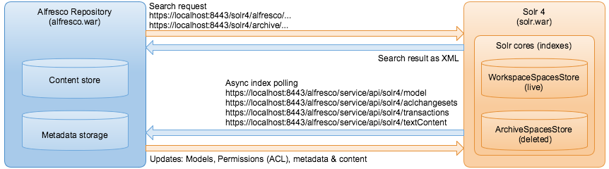
Solr Architecture
20

Slide 21
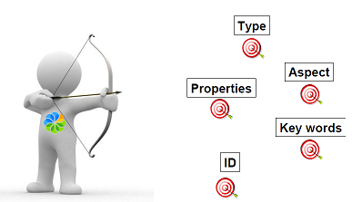
Lucene in Alfresco
Apache Lucene is a highperformance, full-featured text search engine library written entirely in Java.
Lucene in Alfresco enables you to query on:
• The NodeRef (ID)
• The Type > of a Node
• The Properties
• The Aspects
• The key Words(Content)
21

Slide 22
Syntax of query
Type Search-
Syntax : TYPE:”{type name}”
Examples for searching folders
TYPE:"cm:folder“
Property Search-
Syntax: @{prefix}\:{property Name}:”Value to match”
Examples:
@cm\:name:"Buyer"
@cm\:name:"Buy*“
Aspect Search
Syntax: ASPECT:”{aspect name}”
Examples:
ASPECT:"ab:invoice"
22

Slide 23
Cont..
Path Search
Using the path search we can search for for example all nodes that are childs direct or not to defined folder. Lets see few examples.
To select folder test that is under Company Home use:
PATH:"/app:company_home/cm:test“
All directly below folder test
PATH:"/app:company_home/cm:test/*“
All nodes below folder test on any depth
PATH:"/app:company_home/cm:test//*“
All nodes below folder test on any depth and include folder text
PATH:"/app:company_home/cm:test//."
23

Slide 24
Cont..
Search Combinations
This is great but it is not enough, we need search combinations.
Node with certain type and name and so on.
Combinations are achieved using AND, OR and NOT keywords.
Also there is a way for using ‘+’ and ‘-‘.
ASPECT:"ab:invoice" AND NOT -@cm\:description:"Buy*
+TYPE:"sys:base" -@cm\:description:"Buy*
24

Slide 25
Cont..
Example of how to Search :
var query = "TYPE:\"cm:person\" AND @cm\\:userName:\"admin\"";
var def = {
query: query ,
language: "fts-alfresco"
};
var results = search.query(def);
query: string, - mandatory, in appropriate format and encoded for the given language store: string, - optional, defaults to 'workspace://SpacesStore'
language: string, - optional, one of: lucene, xpath, jcr-xpath, fts-alfresco - defaults to 'lucene'
25

Slide 26
Workflow
Work flow is a sequence of connected tasks applied to a document or other item of content. Each task can be performed by a person, a group, or automatically
Alfresco Content Services includes the Process Engine as standard. You can create custom workflows to manage your business processes.
26

Slide 27
Cont..
OOTB Workflow definitions
Adhoc
Enables you to assign a task to a single user
Group Review & Approve
Enables you to set up review and approval of content, assigning the workflow task to a single group
Parallel Review & Approve
Enables you to set up review and approval of content, assigning the workflow task to multiple users.
Pooled Review & Approve
Enables you to set up review and approval of content, assigning the workflow task to multiple users. One user can take ownership of the task at a time, completing it or returning it to the pool to be claimed by another user associated with the task.
Review & Approve
Enables you to set up review and approval of content, assigning the workflow task to a single user
27

Slide 28
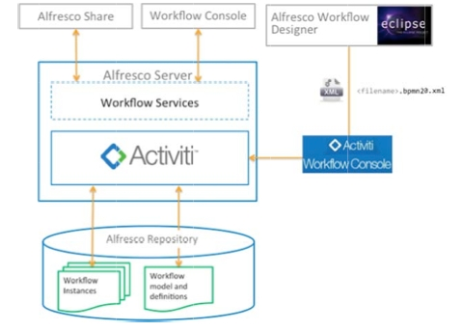
Workflow Architecture
The following figure shows the high‐level architecture for Alfresco workflow
28
28

Slide 29
Cont..
Process Definition
Activiti process definitions describe the events, activities (tasks) and gateways (choices) of a workflow.
Tasks may be user tasks or script (system) tasks. User tasks are assigned to human performers (users). System tasks perform some kind of operation against the Alfresco repository.
Both are described and implemented in the Process Definition.
Task Model
The Task Model provides a description for each of the user tasks in the workflow. Each task description consists of:
Name and Title.
Properties and Associations.
For example, the information attached to the task.
29

Slide 30
Cont..
Share Workflow UI
You can customize the presentation of Tasks to the user in Alfresco Share.
Customizing allows:
Control over which Task properties are displayed
Control over which Task properties are read-only and required
Control over how each Task property is rendered in the forms
Resource Bundle (optional)
A workflow resource bundle provides all the human-readable messages displayed in the user interface for managing the workflow.
Messages include Task titles, task property names, task choices etc. Alfresco supports full localization of Alfresco Share, including workflow.
30

Slide 31
How end users see Workflows
User can see work flows
My Tasks page (User dashboard)
Workflow's I've started page (available form the header menu)
My Tasks dash let (available form the header menu)
Document Workflows component (on the document details page).
User can perform :
Start Workflow (from a pre-defined list of registered Workflows)
Attach resources (i.e. documents) to workflow
Assign workflow participants (i.e. Alfresco users)
List tasks assigned to user (from dashboard)
List tasks completed by user (from dashboard)
List tasks assigned to your pool (from dashboard) - V2.0 onwards
View & Manage Task
Edit task related information
View and perform operations (e.g. checkout, edit, delete) on attached documents
Attach new documents to workflow
Re-assign Task to another user
Mark task as Done (or select pre-defined outcome)
Take ownership or Return to Pool - V2.0 onwards
Cancel workflow
31

Slide 32
References
http://docs.alfresco.com/5.2/concepts/dev-platform-extension-points.html
http://alfrescoblog.com/2014/07/09/alfresco-lucene-tutorial/
http://ecmarchitect.com/alfresco-developer-series-tutorials/behaviors/tutorial/tutorial.html
https://community.alfresco.com/docs/DOC-6319-introduction-to-alfresco-extensions
http://www.quartz-scheduler.org/documentation/quartz-2.x/tutorials/crontrigger.html
http://docs.alfresco.com/5.2/references/APISurf-rootscoped.html
http://docs.alfresco.com/5.2/references/API-JS-rootscoped.html
32

Slide 33
Thank you

